Slide 1
International Business
22MBA401
CORE SUBJECT
                Course Coordinator:
                Prof. Madhunayaka
                Assistant Professor,
                Department of MBA,
                VVIET , Mysuru

Slide 2
Module-3 (7Hours)
Theories of International Business: Introduction, Mercantilism, Theory of absolute cost advantage,
Comparative cost advantage theory, Comparative cost advantage with money, Relative factor endowment theory, Product life cycle theory, Global strategic rivalry theory, Porter’s National Competitive Advantage
Theory.
Contents of MODULE - 3

Slide 3
Theories of International Business: Introduction,
Theories of international business explore the reasons and mechanisms behind trade and investment between countries. These theories help explain patterns of trade, the benefits derived, and the strategies nations and firms employ in the global marketplace. They range from early "country-based" theories focused on national wealth to modern "firm-based" theories examining company strategies.
Role of International Trade Theories in the Evolution of International Business
Understanding Trade Dynamics
Guiding Business Strategies
Informing Policy Decisions
Evolution of International Business
Addressing Global Challenges
Navigating Complexity

Slide 4
Types of International Trade Theories
Mercantilism Theory
Classical Trade Theory
a. Adam Smith’s Absolute Cost Advantage Theory
b. Ricardo’s Comparative Cost Advantage Theory
Hecksher Ohlin’s Factor Endowment Theory
Haberler’s Opportunity Cost Theory
Krugman’s New Trade Theory
Vernon’s International Product Life Cycle Theory
Porter’s National Competitive Advantage Theory

Slide 5
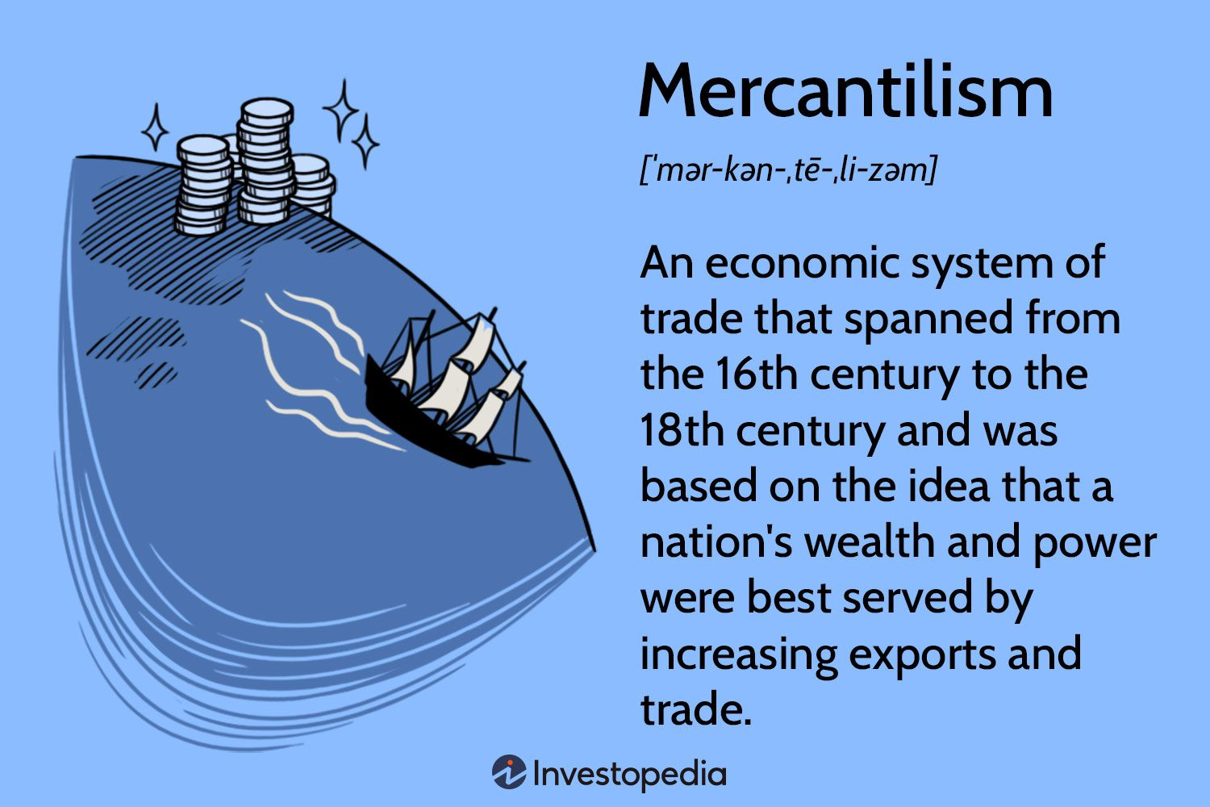
Mercantilism
Core Ideas:
Wealth as Bullion: Mercantilists believed a nation's wealth was measured by its gold and silver reserves.
Trade Surplus: They aimed for exports to exceed imports, believing this would bring in more precious metals.
Government Intervention: Mercantilism supported active government involvement in the economy through tariffs, subsidies, and other regulations to promote exports and restrict imports.
Colonialism: Mercantilist policies often involved establishing colonies to provide raw materials and serve as markets for the mother country's finished goods.

Slide 6
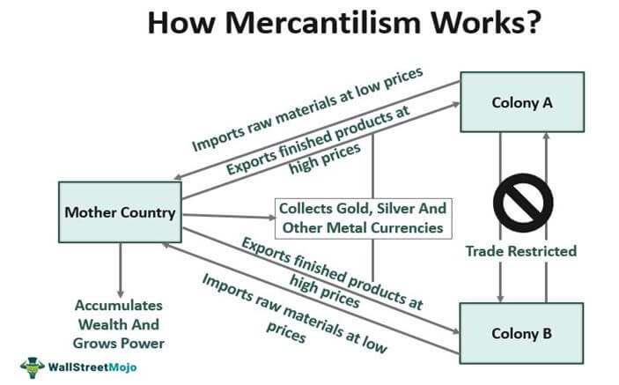
Mercantilism

Slide 7
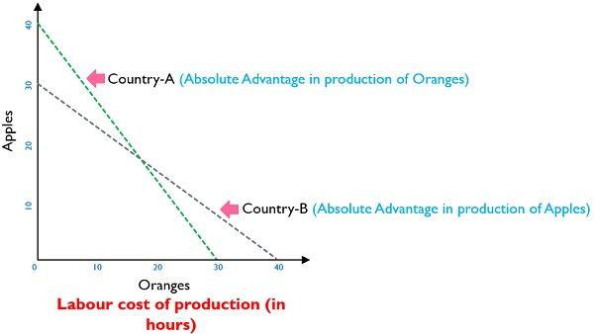
Theory of absolute cost advantage
The theory of absolute cost advantage, primarily associated with Adam Smith(1776), states that countries should specialize in producing and exporting goods where they have a lower production cost than other countries. This theory suggests that free trade based on these cost advantages leads to mutual benefit through increased efficiency and lower prices.
Assumption of Absolute Cost Advantage Theory
Two Countries, Two Commodities
Efficiency Objective
Zero Transportation Costs
Factor Mobility/Immobility
Full Employment

Slide 8
Comparative cost advantage theory
The theory of comparative cost advantage, developed by David Ricardo, explains how countries can benefit from specializing in the production and export of goods they can produce at a lower relative opportunity cost, even if they don't have an absolute advantage in producing all goods. This specialization, coupled with international trade, allows countries to consume more than they could in the absence of trade.
Features of Comparative Cost Advantage Theory
Multiplicity of Organizations and Activities
Two-Edged Sword
Sign of Mixed Partial
Dependence of Comparative Advantage on Relative Value
Not to Create Reasons to Exist
Express in Terms of Money and Labour
No Transport Cost is Unrealistic

Slide 9
Comparative cost advantage with money
Comparative cost advantage, in the context of international trade, refers to a country's ability to produce a good or service at a lower opportunity cost than another country. This means a country can produce something by sacrificing less of other goods or services compared to its trading partners. Even if one country can produce everything more efficiently (absolute advantage), both countries can still benefit from trade by specializing in what they produce best and exchanging goods.
Example:
Imagine two countries, A and B, producing wheat and cloth.
Country A can produce 10 units of wheat or 5 units of cloth with the same resources.
Country B can produce 5 units of wheat or 4 units of cloth with the same resources.
In this case, Country A has an absolute advantage in both goods, as it can produce more of both with the same resources.

Slide 10
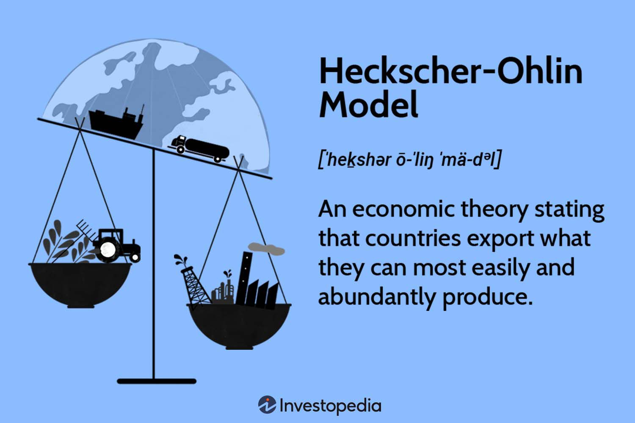
Relative factor endowment theory
The relative factor endowment theory, also known as the Heckscher-Ohlin model, explains that countries will specialize in and export goods that use their relatively abundant factors of production, and import goods that require factors they have less of. This theory suggests that differences in factor endowments (like labor, capital, and land) among countries drive international trade patterns.
Example:
Country A (e.g., China): Abundant in labor, relatively scarce in capital.
Country B (e.g., United States): Abundant in capital, relatively scarce in labor.
Assumptions of Hecksher-Ohlin Theory
Two Countries, Two Products, and Two Factors
Inputs and the Outputs are Perfectly Competitive
Increasing Production of Product Experience Diminishing Returns
Identical Technologies

Slide 11
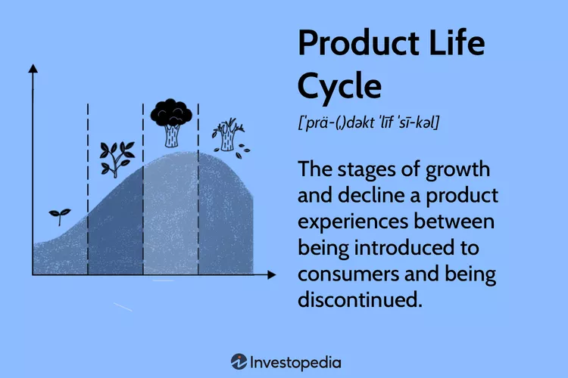
Product life cycle theory
The Product Life Cycle (PLC) theory describes the stages a product goes through from its introduction to the market until it is eventually removed, typically involving introduction, growth, maturity, and decline. This theory helps businesses understand market dynamics, adapt their strategies, and manage resources effectively throughout the product's lifespan

Slide 12
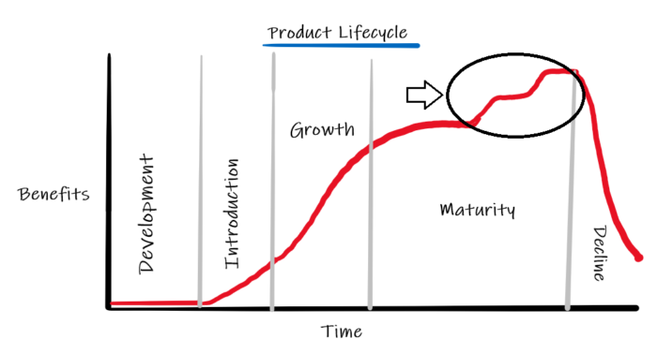
Product life cycle theory
Introduction Stage: As soon as a new product is created , an organization can carry out its production at any place in the world.
Growth Stage: This stage the entrance of competitors and considerably high demands in overseas markets of developed countries.
Maturity Stage: The Global demand tends to stabilize at this stage irrespective of the ups and down of demand in various countries.
Decline Stage: In the last stage, decline the product loses its demand more rapidly in the developed countries as compared to developing countries due to the increased demand of wealthy consumers for new and improved products.

Slide 13
Product life cycle theory
Advantages for Innovative Countries
Sustains Competitive Drive
Stimulate Trade
Enhance a Country’s Comparative Advantages

Slide 14
Global strategic rivalry theory,
Global strategic rivalry theory, developed by Paul Krugman and Kelvin Lancaster, focuses on how multinational corporations (MNCs) compete internationally by using strategies to gain competitive advantages. This theory, emerging in the 1980s, emphasizes firm-level competition and the role of factors like R&D, intellectual property, economies of scale, and market access in driving success in global markets.
Competitive Advantages:
R&D: Investing heavily in research and development to innovate and create superior products or processes.
Intellectual Property (IP): Protecting intellectual property rights (patents, trademarks, etc.) to prevent imitation and maintain a competitive edge.
Economies of Scale: Achieving lower per-unit costs through large-scale production and distribution.
Experience Curve: Leveraging accumulated experience in production and operations to improve efficiency and reduce costs over time.
Market Access: Gaining favorable access to key markets through strategic alliances, distribution networks, or other means.

Slide 15
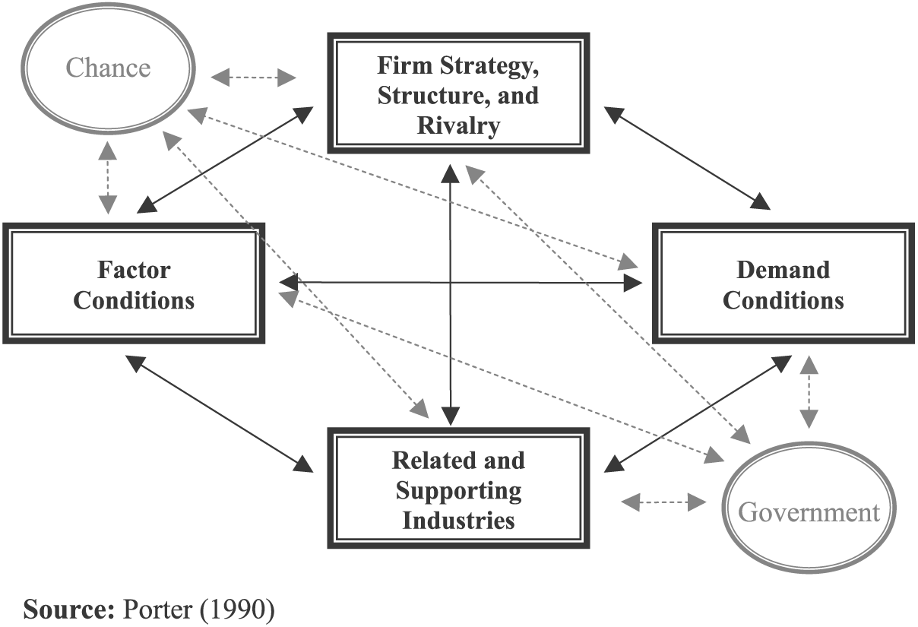
Porter’s National Competitive Advantage Theory.
Porter's National Competitive Advantage theory, also known as the Diamond Model, explains why some nations are more competitive than others in specific industries. It proposes that a nation's competitive advantage stems from four interrelated factors: Factor Conditions, Demand Conditions, Related and Supporting Industries, and Firm Strategy, Structure, and Rivalry. These factors, interacting as a "diamond," create a unique environment that fosters innovation and competitiveness.

Slide 16
International Business
Here's a breakdown of the four factors:
1. Factor Conditions: This refers to a nation's resources, including both basic (e.g., natural resources, climate, location) and advanced factors (e.g., skilled labor, infrastructure, technology). Porter emphasizes that a nation doesn't just inherit these factors; it actively creates them through investment in education, research, and infrastructure.
2. Demand Conditions: This factor focuses on the nature and sophistication of domestic demand. A nation's competitive advantage can be enhanced when domestic customers demand high-quality, innovative products and services, pushing companies to improve and innovate to meet those needs.
3. Related and Supporting Industries: The presence of strong, internationally competitive related and supporting industries within a nation provides crucial inputs, information, and a competitive environment that fosters innovation and efficiency.
4. Firm Strategy, Structure, and Rivalry: The way companies are created, organized, and managed, as well as the intensity of domestic rivalry, significantly impacts a nation's competitiveness. Intense competition among domestic firms pushes them to innovate and improve, leading to a stronger competitive position globally.

Slide 17
Thank You

